Slide 1
Welcome to Arabic Level I by Kurzban. Lesson 8 day 2

Slide 2
Lesson 8: Day 2 الدرس الثامن
Objectives:
Review: Ta marbouta day 2.
Quiz: Next class
Arabic Alphabet: Two- Way connectors
Practice
Summary
Flash card

Slide 3
Do Now: Connect the following letters
ثَ +ب + ب +تَ=
ب + يْ +نَ =
=يَ + بُ + ثُ +ث
ب + يْ+ت =

Slide 4
Review
Identify the letters:
س ، ش، ج، ح، خ، ف، ق، ة
In this excerpt from Arabic newspaper

Slide 5
Try reading the following words.
فتاة

Slide 6
بيت

Slide 8
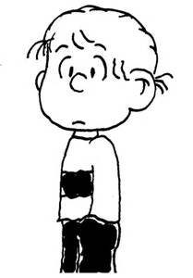

Slide 10
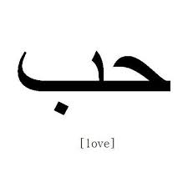

Slide 11
Lesson 8: Review
Copy down the following words on you paper several times and remember to proceed from right to left then undo the words to from the letter that made up the word.
جِدار جَريح سَاخِن زُحار

Slide 12
The Letter ta marbuta and its sound{ة}
The letter ta {ة} is a variant of the regular ta (ت). It serves only as a suffix
The functions it is best known is the feminine marker.
When this letter is attached to most masculine nouns and adjectives, it makes them feminine

Slide 13
Let’s practice
Combine the letters in each set, including short vowels, to form words
جَ + ر+ي + دَ+ ة + ي=
شَ +ر+ ي +فَ +ة =
ح +ا+ رِ+سَ +ة=
خَ +شَ +ب +ة =

Slide 14
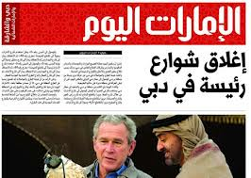
Can you recognize any letters that we have discussed previously.

Slide 15
Recognize any?
آخِرُ خَبَر
سَتَبْدَاُ غَداً الأحَدَ أعْمَالُ الدَورةِ التَدرِيبِيَّةِ للإعْلامِ الزِراعيِّ وَ الَّتِي تُقامُ بِرِعايَةِ السيِّدِ خَليل عَرْنُوق
وزيرِ الزِراعَة.

Slide 16
Meaning
Latest news
Will start Sunday's training session for agricultural information, that is run by the Minister of Agriculture Mr. Khalil عرنوق

Slide 17
Working with fa and qafف and ق
Listen to the following words as you read them, and copy them several times on a ruled sheet of paper:
قَريب خَفيف رَقِيق شُروق

Slide 18
Review
Review
Make your flash card for this lesson
Questions????

